Slide 1
Discrete Mathematics (CSC 1204)
Chapter 1
1.2 Propositional Equivalences

Slide 2
Tautology
Tautology: A compound proposition that is always true is called a tautology.
Examples:
a) p ∨ ¬p
b) The professor is either a woman or a man
c) People either like watching TV or they don’t

Slide 3
Contradiction
Contradiction: A compound proposition that is always false is called a contradiction.
Examples:
a) p ∧ ¬p
b) x is prime and x is an even integer greater than 8
c) All men are good and all men are bad

Slide 4
Contingency
Contingency: A compound proposition that is neither a tautology nor a contradiction is called a contingency.
In other words, a compound proposition whose truth value isn’t constant is called a contingency.
Example: p → ¬p

Slide 5
How to determine whether a compound proposition is a Tautology or Contradiction?
The easiest way to see if a compound proposition is a tautology or contradiction is to use a truth table.

Slide 6
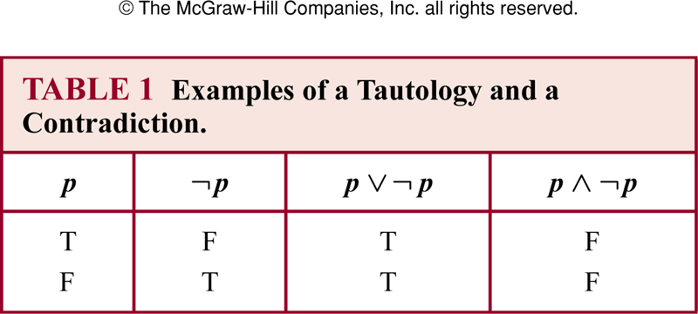
Examples of Tautology and Contradiction

Slide 7
Tautology : Example
Q: Show that [¬p ∧(p ∨q )]→q is a tautology.
Solution: We can show it in two ways:
Using a truth table – show that [¬p ∧(p ∨q )]→q is always true
2) Using a proof (we will get to this later).

Slide 8
Tautology by truth table
p | q | ¬p | p ∨q | ¬p ∧(p ∨q ) | [¬p ∧(p ∨q )]→q
T | T
T | F
F | T
F | F

Slide 9
Tautology by truth table
p | q | ¬p | p ∨ q | ¬p ∧(p ∨q ) | [¬p ∧(p ∨q )]→q
T | T | F
T | F | F
F | T | T
F | F | T

Slide 10
Tautology by truth table
p | q | ¬p | p ∨q | ¬p ∧(p ∨q ) | [¬p ∧(p ∨q )]→q
T | T | F | T
T | F | F | T
F | T | T | T
F | F | T | F

Slide 11
Tautology by truth table
p | q | ¬p | p ∨q | ¬p ∧(p ∨q ) | [¬p ∧(p ∨q )]→q
T | T | F | T | F
T | F | F | T | F
F | T | T | T | T
F | F | T | F | F

Slide 12
Tautology by truth table
p | q | ¬p | p ∨q | ¬p ∧(p ∨q ) | [¬p ∧(p ∨q )]→q
T | T | F | T | F | T
T | F | F | T | F | T
F | T | T | T | T | T
F | F | T | F | F | T
Since the truth table shows all the true values of compound proposition [¬p ∧(p ∨q )]→q are true(T), so it is a tautology.

Slide 13
Class Work
Determine whether ¬ (p ∧ q) ∨ p is a tautology or contradiction.
Determine whether p ∧ (q ∧¬p) is a tautology or contradiction.

Slide 14
Logical Equivalence
Compound propositions that have the same truth values in all possible cases are called logically equivalent.
Definition : Compound propositions p and q are logically equivalent if p ↔ q is a tautology (denoted by p ≡ q or p ⇔ q )

Slide 15
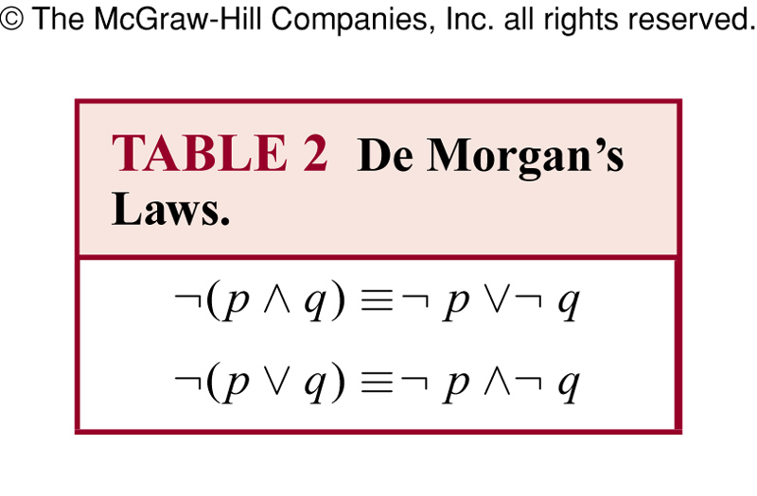
De Morgan’s Laws

Slide 16
Example 2
Show that ¬ (p ∨ q) and ¬p ∧¬q are logically equivalent.

Slide 17
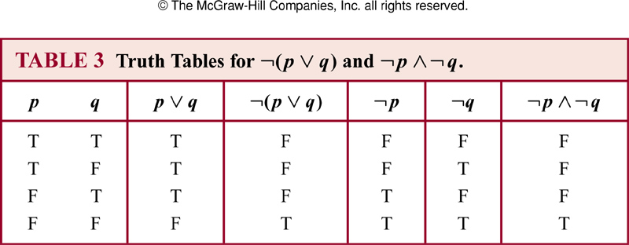
Example 2

Slide 18
Example 2 (page 22)
Because the truth values of the compound proposition ¬ (p ∨ q) and ¬p ∧¬q agree for all possible combinations of the truth values of p and q, it follows that ¬ (p ∨ q) ↔ (¬p ∧¬q ) is a tautology and that these compound propositions are logically equivalent.
Or, you can write..
[ Since the truth values of ¬ (p ∨ q) and ¬p ∧¬q
are same in the corresponding rows, they are logically equivalent ]

Slide 19
Procedure to test whether two compound propositions are logically equivalent
Suppose P and Q be two compound propositions. To test whether two propositions P and Q are logically equivalent, follow the steps below:
Construct the truth table for P
Construct the truth table for Q using the same propositional variables
Check each combinations of truth values of the propositional variables to see whether the value of P is the same as the truth value of Q. If in each row, the truth value of P is the same as the truth value of Q , then P and Q are logically equivalent.

Slide 20
Example 3
Show that p → q and ¬ p ∨ q are logically equivalent.
Solution : Next slide…

Slide 21
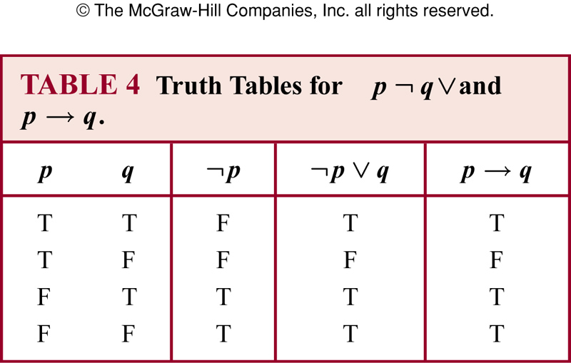
Example 3
Because the truth values of p → q and ¬ p ∨ q agree, they are logically equivalent.

Slide 22
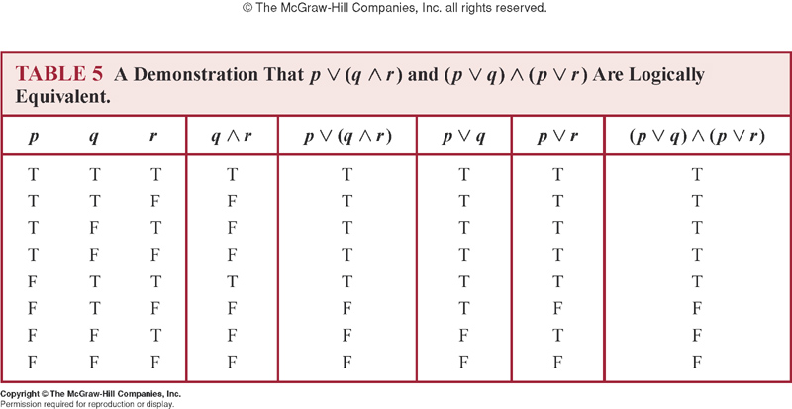
Example 4: Show that p ∨ (q ∧ r ) (p ∨q ) ∧ (p ∨ r ) are logically equivalent
Distributive Law of disjunction over conjunction

Slide 23
Derivational Proof Techniques
When compound propositions involve more and
more propositional variables, the size of the truth
table for the compound propositions increases
Q1: How many rows are required to construct the truth-table of: ( (q ↔ (p→r )) ∧ (¬(s ∧ r) ∨ ¬t) ) → (¬q → r )
Q2: How many rows are required to construct the truth-table of a proposition involving n propositional variables?

Slide 24
Derivational Proof Techniques
A1: 32 rows, each additional variable doubles the number of rows
A2: In general, 2^{n} rows
Therefore, as compound propositions grow in complexity, truth tables become more and more unwieldy. Checking for tautologies/logical equivalences of complex propositions can become a chore, especially if the problem is obvious.

Slide 25
Derivational Proof Techniques
Question: Show that the compound proposition
(p →p ) ∨ (¬(s ∧ r) ∨ ¬t) ) ∨ (¬ q →r ) is a tautology.

Slide 26
Derivational Proof Techniques
Answer : Part of it is a tautology (p →p ) and the
disjunction of True with any other compound
proposition is still True:
(p →p ) ∨ (¬ (s ∧ r) ∨ ¬ t )) ∨ (¬ q →r )
≡ T ∨ (¬ (s ∧ r) ∨ ¬ t )) ∨ (¬ q →r )
≡ T
Derivational techniques formalize the intuition of this example.

Slide 27
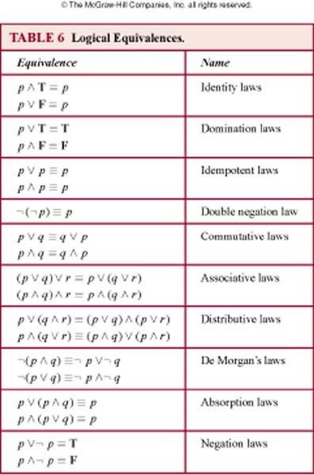
Table 6 ( page 24 ) ➔ Rosen, 7th edition

Slide 28
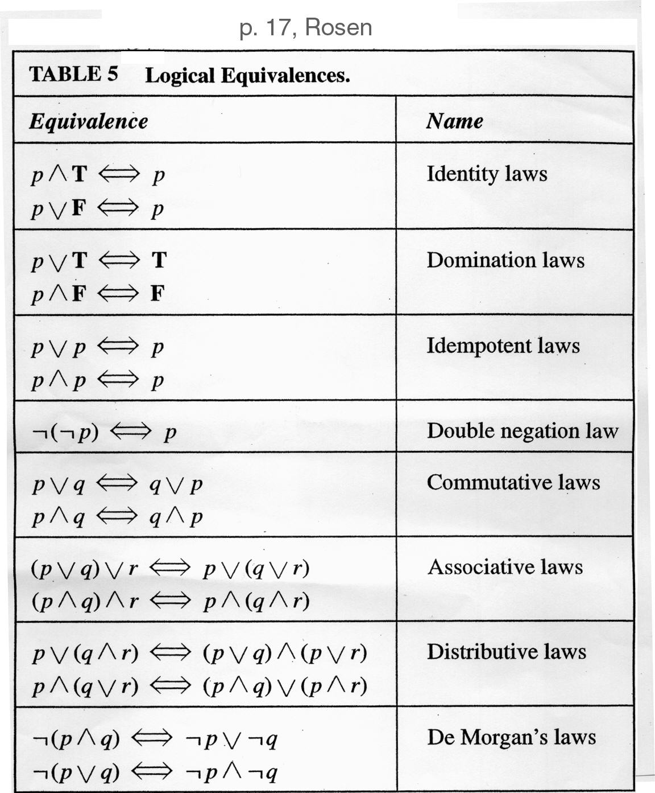
Table of Logical Equivalences (5th Edition, p. 17)
SEE Table 6 ( page 24 ) : Rosen 7th Edition

Slide 30
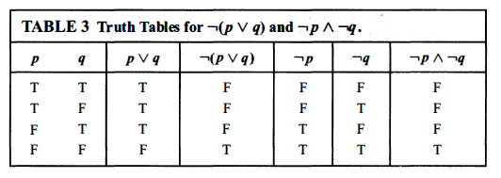
Example 2 : Show that ¬ (p ∨ q) and ¬ p ∧¬q are logically equivalent

Slide 31
A very Useful Logical Equivalence(ULE)
p → q ≡ ¬ p ∨ q

Slide 32
by ULE

Slide 33
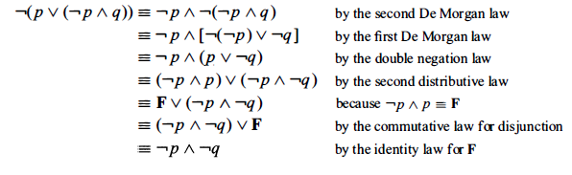
Example 7 (page 26)

Slide 34
Modified Exercise 10(a) [p.28]
Show that [¬p ∧(p ∨q )]→q is a tautology using a series of logical equivalences.
Solution: Next Slide..

Slide 35
Modified Exercise 10(a) [p.28]
[¬p ∧(p ∨q )]→q
≡ [(¬p ∧p)∨(¬p ∧q)]→q Distributive
≡ [ F ∨ (¬p ∧q)]→q Negation
≡ [¬p ∧q ]→q Identity
≡ ¬ [¬p ∧q ] ∨ q ULE
≡ [¬(¬p)∨ ¬q ] ∨ q De Morgan
≡ ( p ∨ ¬q ) ∨ q Double Negation
≡ p ∨ [¬q ∨q ] Associative
≡ p ∨ T Domination
≡ T
So, [¬p ∧(p ∨q )]→q is a tautology

Slide 36
Example 8 ( page 26)

Slide 37
Summary
What is Tautology and Contradiction?
How to show/determine whether two compound propositions are logically equivalent?
Using a truth table
Using logical identities
How to show whether a compound proposition is a tautology?
Using a truth table
Using logical identities
Note: Make sure you learn the important
Logical Equivalences in Table 6 (page 24) &
ULE (e.g. p → q ≡ ¬ p ∨ q )

Slide 38
Practice @ Home
* Practice questions 1-4 without using a Truth Table
Determine whether (¬p ∧ (q →p)) → ¬q is tautology.
Determine whether (¬q ∧ (p →q)) → ¬p is tautology.
Show that [p ∧ (p → q)] → q is a tautology.
Show that [(p →q) ∧(p → r)] and [p → ( q ∧ r)] are logically equivalent.
** Practice relevant Odd-Numbered Exercises
==> 1, 3, 7, 9, 11, 15, 17

Slide 39
Answer 1
(¬p ∧ (q →p)) → ¬q
(¬p ∧ (¬q ∨ p)) → ¬q
((¬p ∧¬q) ∨ (¬p ∧ p)) → ¬q
((¬p ∧¬q) ∨ F) → ¬q
(¬p ∧ ¬q) → ¬q
¬(¬p ∧ ¬q) ∨ ¬q
p ∨ q ∨ ¬q
p ∨ T
T

Slide 40
Answer 2
(¬q ∧ (p →q)) → ¬p
(¬q ∧ (¬p ∨ q)) → ¬p
(¬q ∧¬p) ∨ (¬q ∧ q)) → ¬p
(¬q ∧¬p) ∨ F → ¬p
(¬q ∧¬p) → ¬p
¬(¬q ∧¬p) ∨ ¬p
q ∨ p ∨ ¬p
q ∨ T
T

Slide 41
Answer 3
[p ∧ (p → q)] → q
≡ [p ∧ (¬p ∨ q)] → q
ULE (Substitution for → )
≡ [(p ∧ ¬p) ∨ (p ∧ q)] → q
Distributive Law
≡ [ F ∨ (p ∧ q)] → q
Negation Law
≡ (p ∧ q) → q
Identity Law
≡ ¬(p ∧ q) ∨ q
ULE (Substitution for → )
≡ (¬p ∨ ¬q) ∨ q
First De Morgan’s Law
≡ ¬p ∨ (¬q ∨ q )
Associative Law
≡ ¬p ∨ T
Negation Law
≡ T
Domination Law

